Slide 1
DE Mini Project
Topic: Indian Union Budget Analysis
Group Members-
Hrishit Madhavi (1032220164)
Hrishikesh Iyer (1032220223)
Rujuta Kulkarni (1032220271)
Ayush Patil (1032220274)

Slide 2
Contents
Purpose , Scope and Objectives
Abstract
Introduction
Literature Survey
Dataset Preparation
Dataset Collection
Dataset Preprocessing
Model Development
Result and Visualization

Slide 3
Purpose , Scope and Objectives
Problem Statement: To analyse the annual budget of the Indian Union based on various domains and sectors
Purpose:
  To draw outlines for possible improvements in various sectors based on current trends
  Hence draw upon various suggestions as inferences from this analysis
Objectives:
  To analyse the current budget and that of past Financial Years
  To visualise the evolution of the share of sectors (wrt budget % allocated)
  To draw inferences from this analysis
  To provide suggestions/predictions

Slide 4
Scope, Introduction, Abstract
Scope:
The analysis spans several years of the Indian Union Budget, providing a multi-year view of economic trends. The focus is on predicting changes in key metrics such as GDP per capita, population, HDI, and life expectancy. The study covers various sectors, including health, education, defense, and infrastructure, offering a national perspective on the budget's impact.
. Introduction
The Indian Union Budget is a critical framework that outlines the government's fiscal policies and financial allocations for the upcoming year. This project aims to analyze the Indian Union Budget data to identify trends and predict how various financial attributes influence one another. By employing statistical techniques, this analysis will enhance our understanding of the budget's impact on economic growth and public welfare.
Abstract
  The Indian Union Budget serves as a vital tool for influencing the nation’s economic strategies and priorities. This project offers an in-depth analysis of the Indian Union Budget through the lens of big data technologies, emphasizing the application of advanced data analytics to extract meaningful insights. As the volume and complexity of budgetary data continue to grow each year, conventional analysis techniques fall short. Utilizing frameworks such as Apache Spark and various Python-based data science libraries, we explore extensive datasets that encompass historical budget allocations, revenue trends, and expenditure patterns. This project aims to enhance understanding and decision-making in the context of public finance by leveraging cutting-edge analytical methods.

Slide 5
Literature Survey

Slide 6
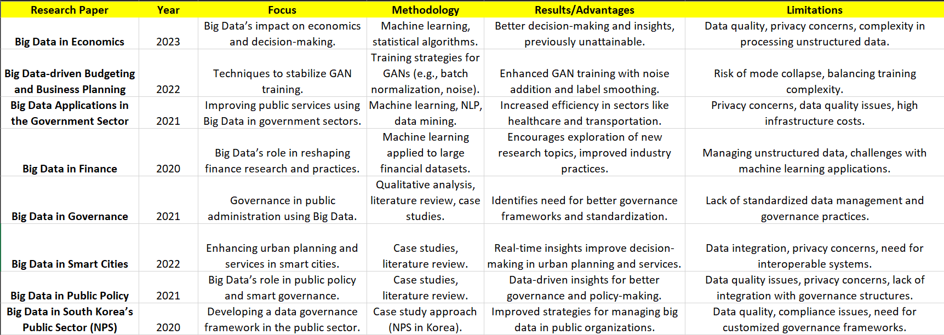

Slide 7
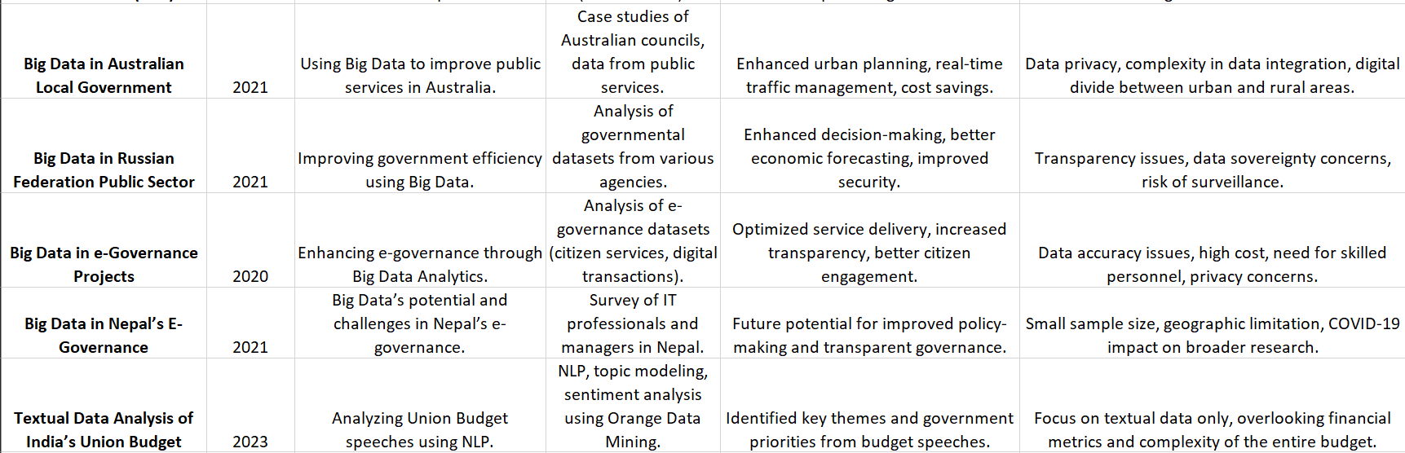

Slide 8
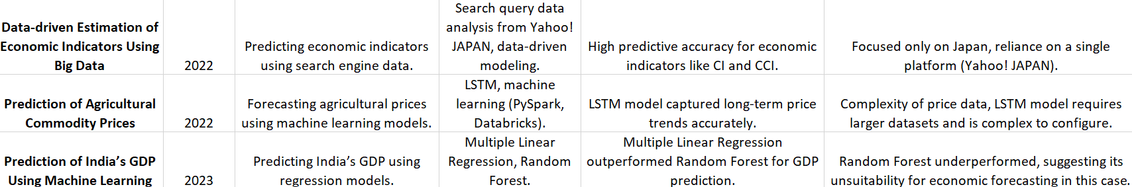

Slide 9
Dataset Preparation
Preparation
Collection

Slide 10
The first step involved gathering data from official sources such as government websites, kaggle; which provided us with state-wise budget allocation data for different financial years (2013-14 and 2024-25 in this case). This is crucial in data engineering as working with real-world data often starts with data acquisition from trustworthy sources. For this project, the data was likely sourced in a tabular format (like Excel or CSV files), which is common in data analysis tasks.

Slide 11
Sources of the Dataset
We have identified different data sources for the budget analysis for our project which include:
Indian Gov. Budget website (https://openbudgetsindia.org/dataset)
Gov. of India data website (https://openbudgetsindia.org/dataset)
Economic Serveys of Gov. of India (https://www.indiabudget.gov.in/economicsurvey/)
Converting Unstructured Data into Structured-
Budget Speeches and Budget Provisions to the structured data format and further using it.
https://www.indiabudget.gov.in/bspeech.php

Slide 12
Data Processing
Preparation
Collection
Preprocessing

Slide 13
Data Cleaning:
Data is often incomplete, noisy, or inconsistent. In this project, the dataset had missing values (NaN), which were handled by either filling missing values with 0 or removing invalid data. Cleaning ensures that the dataset is consistent and reliable, avoiding errors during analysis and visualization.
Data Transformation:
Data transformation involves converting the data into a more suitable format for analysis. In this case, we set appropriate column headers, ensured correct indexing by state names, and performed type conversions where necessary. This helped us prepare the dataset for further analysis and visualizations.
Data Integration:
Since the project involved comparing different financial years, integration was necessary to combine the data into a unified format. We combined the 2024-25 and 2013-14 data for better comparative analysis.
Data Reduction:
Data reduction is the process of reducing the volume but maintaining the integrity of the dataset. Although we worked with the full dataset here, we could have applied reduction techniques like aggregating data to a higher level (e.g., grouping smaller states) if needed for simplification.

Slide 14
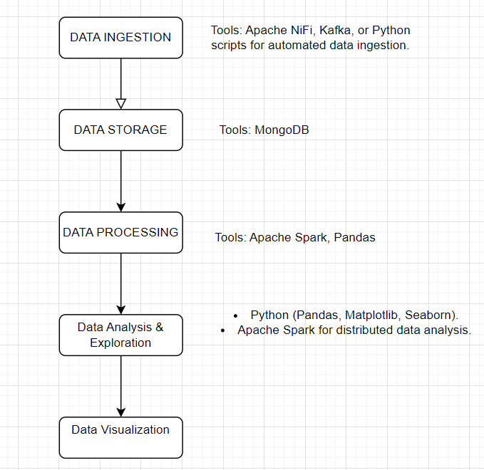

Slide 15
Preprocessing
Data Cleaning:
We handled missing data using two main approaches. In some cases, irrelevant records with too many missing values were removed (ignoring the tuple). For other cases, missing values were filled using the mean of the respective attribute, ensuring that the dataset remained balanced and complete.
Some of the outliers were smoothed using regression techniques to better fit the data trend.
Date Transformation:
We applied Min-Max Normalisation, scaling all numerical values between 0 and 1 to ensure that no single attribute dominated others due to magnitude differences. This normalisation was essential for accurate performance in the linear regression models.
For some models, Z-Score Normalisation was applied, particularly when working with data that followed a normal distribution. This technique centred the data around a mean of 0 with a standard deviation of 1, ensuring equal contribution of all features.

Slide 16
Preprocessing
Attribute Selection:
Only relevant attributes were selected for the final analysis. For instance, in predicting GDP per capita, variables related to fiscal deficits and government spending were retained, while less relevant attributes were excluded.
Discretisation:In cases where continuous data needed to be grouped, attributes were discretised into intervals. This was particularly useful for models that required categorical input data.
Data Reduction:
High-dimensional data was reduced by selecting a subset of important attributes, ensuring the model was more efficient without sacrificing accuracy.

Slide 17
Model Development

Slide 18
Linear Regression
• Year vs. Population: A linear regression model was applied to predict future population trends. The model showed consistent growth in population over time.
• Year vs. GDP Per Capita: This model predicted an increase in GDP per capita, reflecting positive economic growth over the years.
• Year vs. HDI and Life Expectancy: The model projected improvements in human development indicators, including life expectancy, based on historical data.
The results from the regression models were used to generate predictions, offering insights into how budgetary allocations affect population growth, economic health, and human development indicators.

Slide 19
Outcome and Visualization

Slide 20
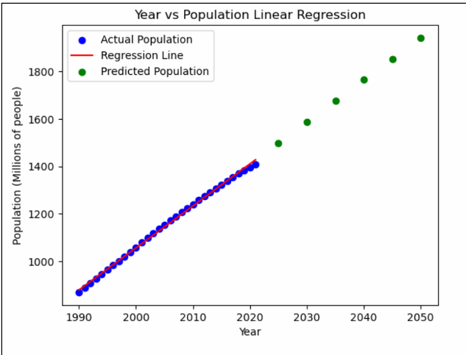
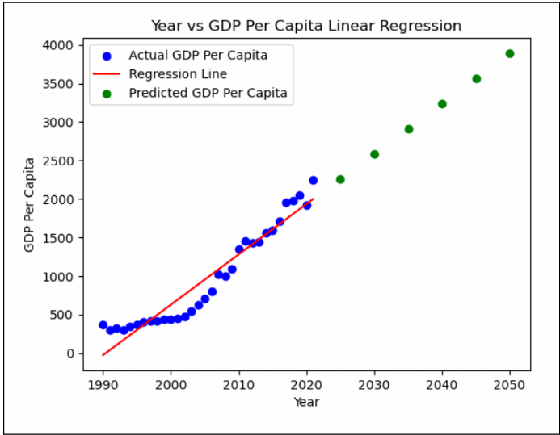
Year -Population
Year- GDP per Capita

Slide 21
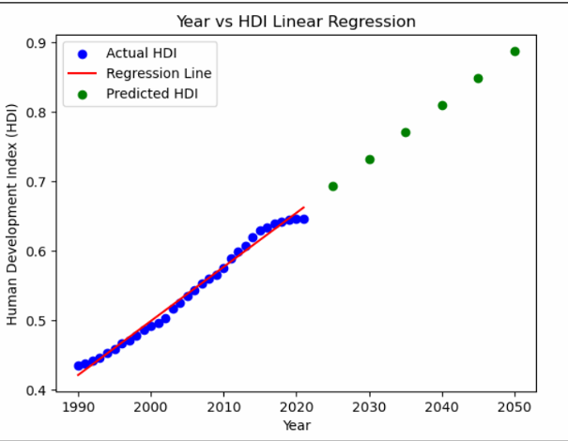
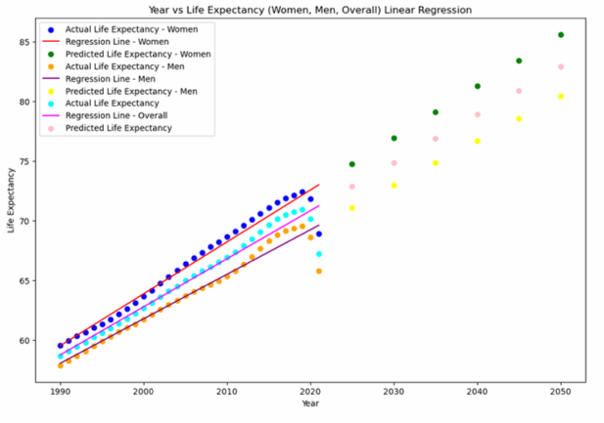
Year vs HDI
Year vs Life Expectancy

Slide 22
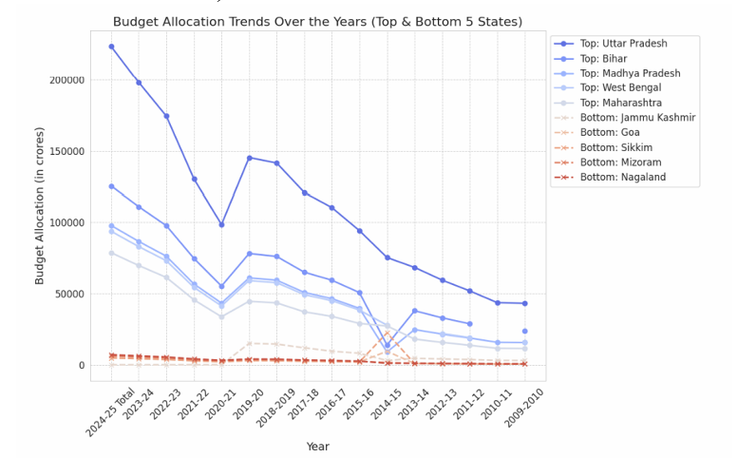
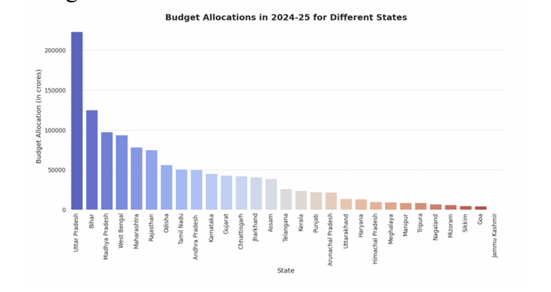
Budget Allocation Trends
Budget Allocation in 2024-25 in Different Satates

Slide 23
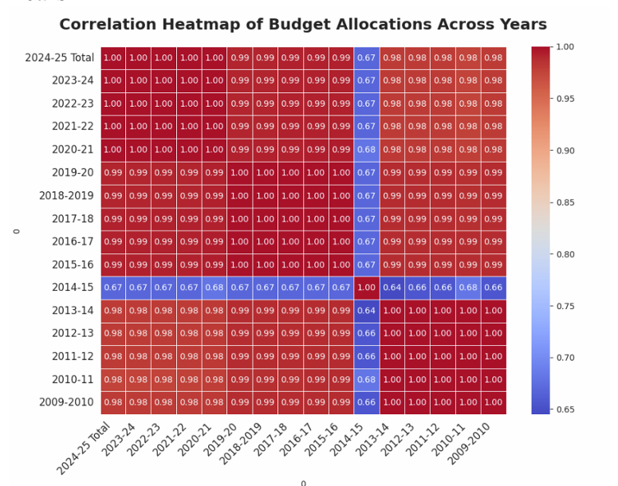
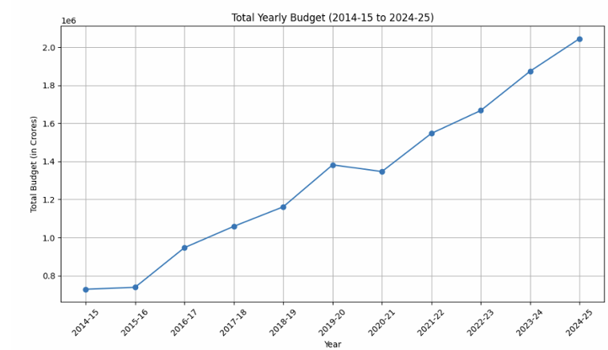
Correlation Analysis using Heatmap
Total Yearly Budget trends

Slide 24
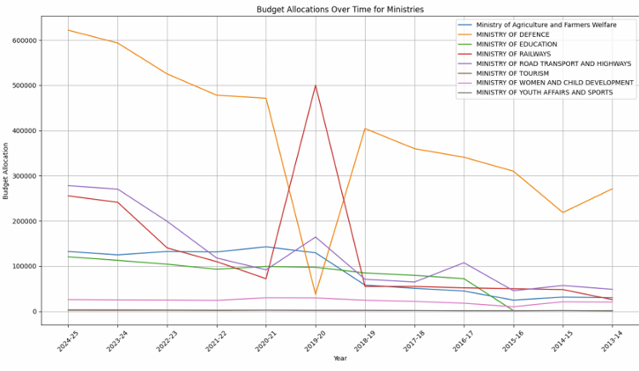
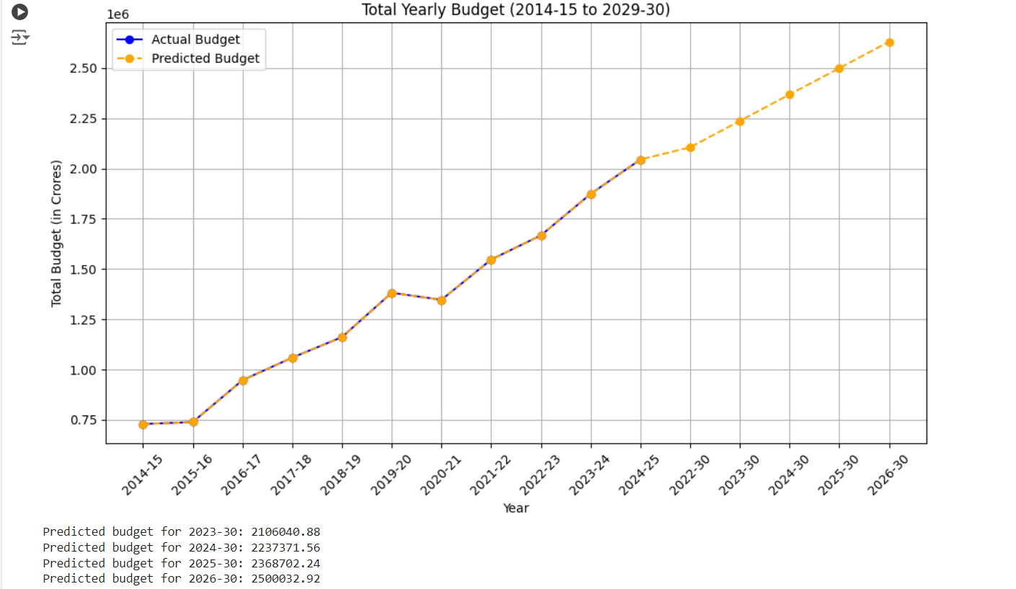
Ministries Budget Allocation

Slide 25
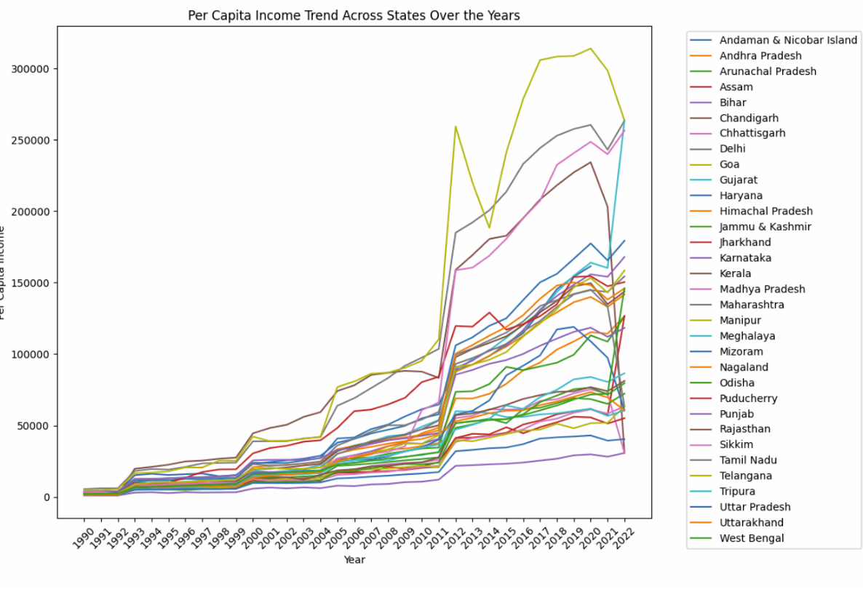
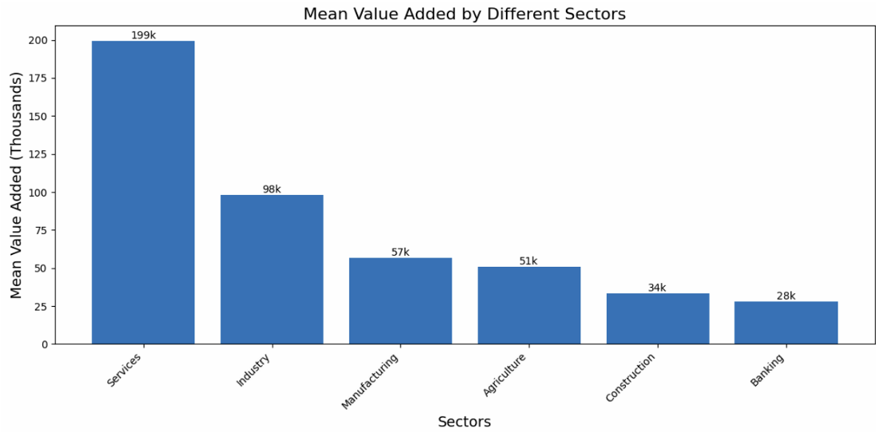
Per Capita of Different States
Mean Value Added bt Different Sectors

Slide 26
References
[1]Bogdan OANCEA.Big data in economics.University of Bucharest, Faculty of Business and Administration, Department of Economic and Administrative Sciences.
[2]Alessio Faccia.Big Data-driven Budgeting and Business Planning.doi:10.20944/preprints202009.0747.v1
[3]GANG-HOON KIM, SILVANA TRIMI, AND JI-HYONG CHUNG.Big Data Applications in the Government Sector: A Comparative Analysis among Leading Countries.March 2014.Communications of the ACM 57(3):78-85.DOI:10.1145/2500873
[4] Itay Goldstein.Big Data in Finance.The Review of Financial Studies, Volume 34, Issue 7, July 2021, Pages 3213–3225, https://doi.org/10.1093/rfs/hhab038
[5] Alexander Yukhno1.Digital Transformation: Exploring big data Governance in Public Administration.https://doi.org/10.1007/s11115-022-00694-x
[6]Md Altab Hossin , Jie Du, Lei Mu, and Isaac Owusu Asante.Big Data-Driven Public Policy Decisions: Transformation Toward Smart Governance.DOI: 10.1177/21582440231215123 journals.sagepub.com/home/sgo
[7]Hee Yeong Kim June-Suh Cho.Data governance framework for big data implementation with NPS Case Analysis in Korea.Journal of Business and Retail Management Research (JBRMR), Vol. 12 Issue 3
[8]Richard B. Watson and Peter J. Ryan .Big Data Analytics in Australian Local Government.
[9]Kuraeva Anna, Kazantsev Nikolay.SURVEY ON BIG DATA ANALYTICS IN PUBLIC SECTOR OF RUSSIAN FEDERATION.Procedia Computer Science 55 ( 2015 ) 905 – 911

Slide 27
References
[10]Arun Kishor Sahani & R.N. Thakur.BIG DATA ANALYTICS AND E-GOVERNANCE
POSSIBILITIES AND BARRIERS IN NEPAL.ISSN: 2705-4683; e-ISSN: 2705-4748
[11]Preet Navdeep, Dr. Manish Arora And Dr. Neeraj Sharma.Role of Big Data Analytics in Analyzing e-Governance Projects.GIAN JYOTI E-JOURNAL, Volume 6, Issue 2 (Apr-Jun 2016) ,10th International Conference on‘New Trends in Business and Management: An International Perspective’
[12]Goshi Aoki, Kazuto Ataka, Takero Doi , Kota Tsubouchi.Data-driven estimation of economic indicators with search big data in discontinuous situation.The Journal of Finance and Data Science 9 (2023) 100106
[13]Humaira Rana,Muhammad Umer Farooq.Prediction of Agricultural Commodity Prices using Big Data Framework.DOI: https://doi.org/10.48084/etasr.6468
[14Kirti Makwana.A Textual Data Analysis of the UnionBudget of India.INDIAN JOURNAL OF SCIENCE AND TECHNOLOGY

Slide 28
Thank you!

